Slide 1
Computer Organization
2015 - 2016

Slide 2
Instructions
Language of The Computer
(MIPS)

Slide 3
Exercise 1
Assuming A is an integer array with base in $s4 and that the compiler associates the integer variables g, i, and n with the registers $s1, $s2, and $s3, respectively
What is the compiled MIPS assembly code for the following C code segment?
i=0;
while(i < n)
{
g = g + A[i];
i++;
}

Slide 4
Exercise 1 Sol.
add $s2, $zero, $zero # i = 0
while: slt $t0, $s2, $s3 # test if i < n
beq $t0, $zero, Exit
sll $t1, $s2, 2 # $t1 = 4*i
add $t1, $t1, $s4 # $t1 has address of A[i]
lw $t2, 0 ($t1) # $t2 = A[i]
add $s1, $s1, $t2
addi $s2, $s2, 1 # increment i
j while
Exit:

Slide 5
Decision Making Instructions (cont.)
There are two ways to implement case/switch statements: –
Turn a switch statement into a chain of if-then-else statements in the high-level language and then into chained conditional jumps MIPS
Encode a table of addresses of alternative instruction sequences, called a jump address table ( Jump Table)

Slide 6
Exercise 2
Assume the six integer variables f through k correspond to the six registers $s0 through $s5
What is the compiled MIPS assembly code for the following C code segment?
switch (k)
{
case 0: f = i + j; break;
case 1: f = g + h; break;
case 2: f = g -h; break;
case 3: f = i -j; break;
}

Slide 7
Exercise 2 Sol. Chain of if-else
beq $s5,$zero, L0 # if k=0 branch to L0
add $t0,$zero, $zero # $t0=0
addi $t0, $t0, 1 # $t0=1
beq $s5, $t0, L1 # if k=1 branch to L1
addi $t0, $t0, 1 # $t0=2
beq $s5, $t0, L2 # if k=2 branch to L2
addi $t0, $t0, 1 # $t0=3
beq $s5, $t0, L3 # if k=2 branch to L3
j Exit

Slide 8
Exercise 2 Sol. Chain of if-else
L0: add $s0,$s3, $s4 # f = i + j
j Exit # break
L1: add$ $s0,$s1, $s2 # f = g + h
j Exit # break
L2: sub $s0,$s1, $s2 # f = g –h
j Exit # break
L3: sub $s0,$s3, $s4 # f = i –j
j Exit # break
Exit:

Slide 9
Exercise 2 Sol. Jump Table
the Jump Table is just an array of words containing addresses that correspond to labels in the code
the program loads the appropriate entry from JumpTable into a register and then it jumps to the proper address using a jump register (jr)
To access the JumpTable, assume that four sequential words in memory, starting at an address contained in register $t4, have addresses corresponding to the labels L0, L1, L2, and L3

Slide 10
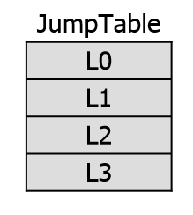
Exercise 2 Sol. Jump Table
slt $t3,$s5, $zero # test if k < 0
bne $t3,$zero, Exit # exit if k < 0
slti $t3,$s5, 4 # test if k < 4
beq $t3,$zero, Exit # exit if k ≥4
sll $t1,$s5, 2 # $t1 = 4*k
add $t1,$t1, $t4 # JumpTable[k] address
jr $t1 # jump register

Slide 11
Exercise 2 Sol. Jump Table
L0: add $s0,$s3, $s4 # f = i + j
j Exit # break
L1: add$ s0,$s1, $s2 # f = g + h
j Exit # break
L2: sub $s0,$s1, $s2 # f = g –h
j Exit # break
L3: sub $s0,$s3, $s4 # f = i –j
j Exit # break
Exit:

Slide 12
Instruction Formats
Register format: R-format
Used by arithmetic and logical instructions
Immediate format: I-format
Used by data transfer instructions
Used by instructions that have immediate operands
Used by relative-address branching
Jump format: J-format
Used by absolute-jump instructions

Slide 13
Instruction Formats (cont.)

Slide 14
Instruction Formats (cont.)
op: basic operation of the instruction, traditionally called opcode
rs: the first register source operand
rt: the second register source operand in R-format. This field sometimes specifies a destination register in I-format
rd: the register destination operand that gets the operation result
shamt: shift amount, used in shift instructions
Funct: function code that selects the specific variant of the operation in the op field in R-format

Slide 15
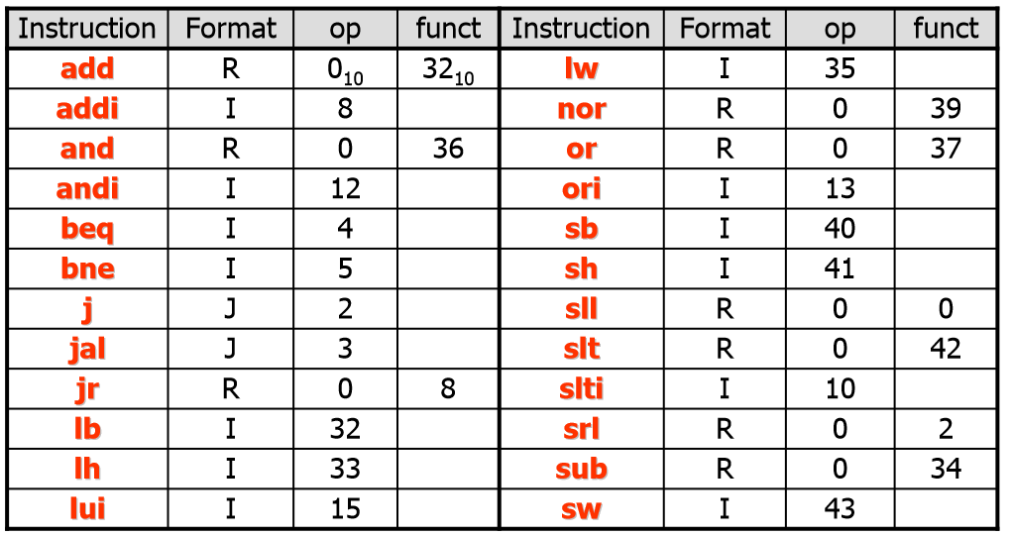

Slide 16
Exercise 3
Show the real MIPS machine language version for the instruction represented symbolically as
add $t0, $s1, $s2
Registers have numbers: $t0 = 8, $s1 = 17, $s2 = 18

Slide 17
Exercise 3 Sol.
add $t0, $s1, $s2
$t0 = 8, $s1 = 17, $s2 = 18

Slide 18
Exercise 4
Show the real MIPS machine language code for the following instruction:
sll $t2, $s0, 4
Registers have numbers: $t2 = 10, $s0 = 16

Slide 19
Exercise 4 Sol.
sll $t2, $s0, 4
$t2 = 10, $s0 = 16

Slide 20
Exercise 5
Assemble the following MIPS instruction into real MIPS machine code:
lw $t0, 32 ($s3)
Registers have numbers: $t0 = 8, $s3 = 19

Slide 21
Exercise 5 Sol.
lw $t0, 32 ($s3)
$t0 = 8, $s3 = 19

Slide 22
Exercise 6
Show the real MIPS machine language version for the instruction
addi $s1, $s2, 4
Registers have numbers: $s1 = 17, $s2 = 18

Slide 23
Exercise 6 Sol.
addi $s1, $s2, 4
$s1 = 17, $s2 = 18

Slide 24
Exercise 7
Assuming that integer array A has its base in $t1 and that $s2 corresponds to integer variable h, show the real MIPS machine language code for
A[300] = h + A[300];
Registers have numbers: $t0 = 8, $t1 = 9, $s2 = 18
MIPS: lw $t0,1200($s1)
add $t0,$s2,$t0
sw $t0,1200($s1)

Slide 25
Exercise 7 Sol.

